Slide 1
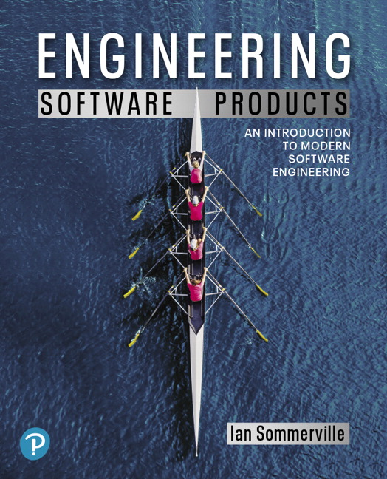
Engineering Software Products
First Edition
Chapter 8
Reliable Programming
Copyright © 2020, Pearson Education, Inc. All Rights Reserved

Slide 2
Software quality
Creating a successful software product does not simply mean providing useful features for users.
You need to create a high-quality product that people want to use.
Customers must be confident that your product will not crash or lose information, and users must be able to learn to use the software quickly and without mistakes.

Slide 3
Figure 8.1
Product quality attributes

Slide 4
Software dependability
In general, software customers expect all software to be dependable. However, for non-critical applications, they may be willing to accept some system failures.
Some applications (critical systems) have very high dependability requirements and special software engineering techniques may be used to achieve this.
Medical systems
Telecommunications and power systems
Aerospace systems

Slide 5
Dependability achievement
Fault avoidance
The system is developed in such a way that human error is avoided and thus system faults are minimized.
The development process is organized so that faults in the system are detected and repaired before delivery to the customer.
Fault detection
Verification and validation techniques are used to discover and remove faults in a system before it is deployed.
Fault tolerance
The system is designed so that faults in the delivered software do not result in system failure.

Slide 6
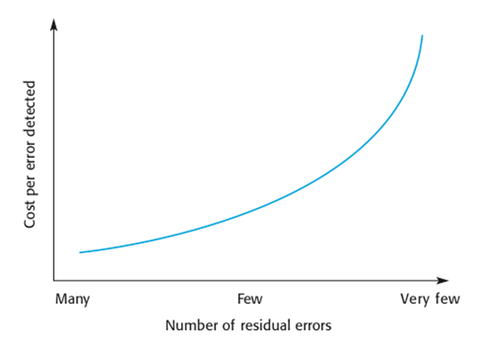
The increasing costs of residual fault removal

Slide 7
Regulated systems
Many critical systems are regulated systems, which means that their use must be approved by an external regulator before the systems go into service.
Nuclear systems
Air traffic control systems
Medical devices
A safety and dependability case must be approved by the regulator. Therefore, critical systems development must create the evidence to convince a regulator that the system is dependable, safe and secure.

Slide 8
Diversity and redundancy
Redundancy
Keep more than 1 version of a critical component available so that if one fails then a backup is available.
Diversity
Provide the same functionality in different ways so that they will not fail in the same way.
However, adding diversity and redundancy adds complexity and this can increase the chances of error.
Some engineers advocate simplicity and extensive V & V is a more effective route to software dependability.

Slide 9
Diversity and redundancy examples
Redundancy. Where availability is critical (e.g. in e-commerce systems), companies normally keep backup servers and switch to these automatically if failure occurs.
Diversity. To provide resilience against external attacks, different servers may be implemented using different operating systems (e.g. Windows and Linux)

Slide 10
Process diversity and redundancy
Process activities, such as validation, should not depend on a single approach, such as testing, to validate the system
Rather, multiple different process activities the complement each other and allow for cross-checking help to avoid process errors, which may lead to errors in the software

Slide 11
Dependable processes
To ensure a minimal number of software faults, it is important to have a well-defined, repeatable software process.
A well-defined repeatable process is one that does not depend entirely on individual skills; rather can be enacted by different people.
Regulators use information about the process to check if good software engineering practice has been used.
For fault detection, it is clear that the process activities should include significant effort devoted to verification and validation.

Slide 12
Attributes of dependable processes
Process characteristic | Description
Documentable | The process should have a defined process model that sets out the activities in the process and the documentation that is to be produced during these activities.
Standardized | A comprehensive set of software development standards covering software production and documentation should be available.
Auditable | The process should be understandable by people apart from process participants, who can check that process standards are being followed and make suggestions for process improvement.
Diverse | The process should include redundant and diverse verification and validation activities.
Robust | The process should be able to recover from failures of individual process activities.

Slide 13
Validation activities
Requirements reviews.
Requirements management.
Formal specification.
System modelling.
Design and code inspection.
Static analysis.
Test planning and management.
Change management is also essential.

Slide 14
Fault tolerance
In critical situations, software systems must be fault tolerant.
Fault tolerance is required where there are high availability requirements or where system failure costs are very high.
Fault tolerance means that the system can continue in operation despite software failure.
Even if the system has been proved to conform to its specification, it must also be fault tolerant as there may be specification errors or the validation may be incorrect.

Slide 15
Dependable system architectures
Dependable systems architectures are used in situations where fault tolerance is essential. These architectures are generally all based on redundancy and diversity.
Examples of situations where dependable architectures are used:
Flight control systems, where system failure could threaten the safety of passengers
Reactor systems where failure of a control system could lead to a chemical or nuclear emergency
Telecommunication systems, where there is a need for 24/7 availability.

Slide 16
Protection systems
A specialized system that is associated with some other control system, which can take emergency action if a failure occurs.
System to stop a train if it passes a red light
System to shut down a reactor if temperature/pressure are too high
Protection systems independently monitor the controlled system and the environment.
If a problem is detected, it issues commands to take emergency action to shut down the system and avoid a catastrophe.

Slide 17
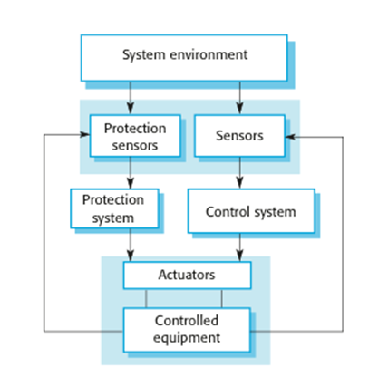
Protection system architecture

Slide 18
Self-monitoring architectures
Multi-channel architectures where the system monitors its own operations and assumed, if inconsistencies are detected.
The same computation is carried out on each channel and the results are compared. If the results are identical and are produced at the same time, then it is assumed that the system is operating correctly.
If the results are different, then a failure is assumed, and a failure exception is raised.

Slide 19
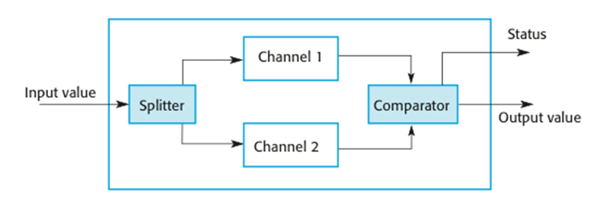
Self-monitoring architecture

Slide 20
Self-monitoring systems
Hardware in each channel has to be diverse so that common mode hardware failure will not lead to each channel producing the same results.
Software in each channel must also be diverse, otherwise the same software error would affect each channel.
If high-availability is required, you may use several self-checking systems in parallel.
This is the approach used in the Airbus family of aircraft for their flight control systems.

Slide 21
Airbus
The Airbus FCS has 5 separate computers, anyone of which can run the control software
Extensive use has been made of diversity
Primary systems us a different processor from the secondary systems
Primary and secondary systems use chipsets from different manufacturers
Software in secondary systems is less complex than in primary system - provides only critical functionality
Software in each channel is developed in different programming languages by different teams
Different programming languages used in primary and secondary systems

Slide 22
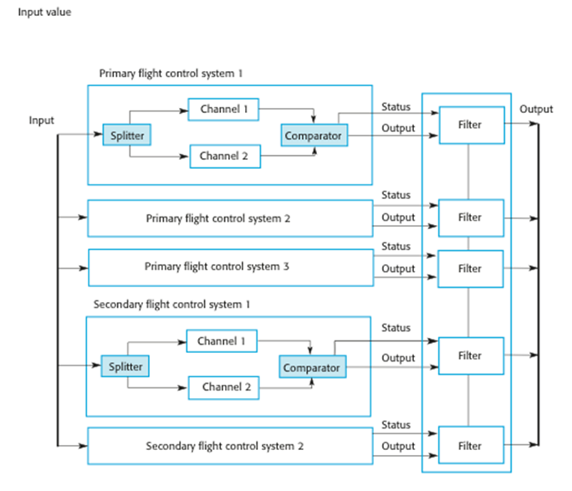
Airbus flight control system architecture

Slide 23
Protection system functionality
Protection systems are redundant because they include monitoring and control capabilities that replicate those in the control software.
Protection systems should be diverse and use different technology from the control software.
They are simpler than the control system so more effort can be expended in validation and dependability assurance.
Aim is to ensure that there is a low probability of failure on demand for the protection system.

Slide 24
Programming for reliability
There are three simple techniques for reliability improvement that can be applied in any software company.
Fault avoidance You should program in such a way that you avoid introducing faults into your program.
Input validation You should define the expected format for user inputs and validate that all inputs conform to that format.
Failure management You should implement your software so that program failures have minimal impact on product users.

Slide 25
Figure 8.2
Underlying causes of program errors

Slide 26
Figure 8.3
Software complexity

Slide 27
Program complexity (1 of 2)
Complexity is related to the number of relationships between elements in a program and the type and nature of these relationships
The number of relationships between entities is called the coupling. The higher the coupling, the more complex the system.
The shaded node in the previous figure has a relatively high coupling because it has relationships with six other nodes.

Slide 28
Program complexity (2 of 2)
A static relationship is one that is stable and does not depend on program execution.
Whether or not one component is part of another component is a static relationship.
Dynamic relationships, which change over time, are more complex than static relationships.
An example of a dynamic relationship is the ‘calls’ relationship between functions.

Slide 29
Types of complexity (1 of 2)
Reading complexity This reflects how hard it is to read and understand the program.
Structural complexity This reflects the number and types of relationship between the structures (classes, objects, methods or functions) in your program.

Slide 30
Types of complexity (2 of 2)
Data complexity This reflects the representations of data used and relationships between the data elements in your program.
Decision complexity This reflects the complexity of the decisions in your program

Slide 31
Table 8.1 Complexity reduction guidelines
Type | Guideline
Structural complexity | Functions should do one thing and one thing only. Functions should never have side effects. Every class should have a single responsibility. Minimize the depth of inheritance hierarchies. Avoid multiple inheritance. Avoid threads (parallelism) unless absolutely necessary.
Data complexity | Define interfaces for all abstractions. Define abstract data types. Avoid using floating-point numbers. Never use data aliases.
Decision complexity | Avoid deeply nested conditional statements. Avoid complex conditional expressions.

Slide 32
Ensure that every class has a single responsibility (1 of 2)
You should design classes so that there is only a single reason to change a class.
If you adopt this approach, your classes will be smaller and more cohesive.
They will therefore be less complex and easier to understand and change.

Slide 33
Ensure that every class has a single responsibility (2 of 2)
The notion of ‘a single reason to change’ is, I think, quite hard to understand. However, in a blog post, Bob Martin explains the single responsibility principle in a much better way:
Gather together the things that change for the same reasons.
Separate those things that change for different reasons.*

Slide 34
Figure 8.4
The DeviceInventory class

Slide 35
Adding a printInventory method (1 of 2)
One way of making this change is to add a printInventory method, as shown in Figure 8.4 (b).
This change breaks the single responsibility principle as it then adds an additional ‘reason to change’ the class.
Without the printInventory method, the reason to change the class is that there has been some fundamental change in the inventory, such as recording who is using their personal phone for business purposes.
However, if you add a print method, you are associating another data type (a report) with the class. Another reason for changing this class might then be to change the format of the printed report.

Slide 36
Adding a printInventory method (2 of 2)
Instead of adding a printInventory method to DeviceInventory, it is better to add a new class to represent the printed report as shown in the next figure.

Slide 37
Figure 8.5
The DeviceInventory and InventoryReport classes

Slide 38
Avoid deeply nested conditional statements
Deeply nested conditional (if) statements are used when you need to identify which of a possible set of choices is to be made.
For example, the function ‘agecheck’ in Program 8.1 is a short Python function that is used to calculate an age multiplier for insurance premiums.
The insurance company’s data suggests that the age and experience of drivers affects the chances of them having an accident, so premiums are adjusted to take this into account.
It is good practice to name constants rather than using absolute numbers, so Program 8.1 names all constants that are used.

Slide 39
Program 8.1 Deeply nested if-then-else statements (1 of 3)
YOUNG_DRIVER_AGE_LIMIT = 25 OLDER_DRIVER_AGE = 70 ELDERLY_DRIVER_AGE = 80
YOUNG_DRIVER_PREMIUM_MULTIPLIER = 2 OLDER_DRIVER_PREMIUM_MULTIPLIER = 1.5 ELDERLY_DRIVER_PREMIUM_MULTIPLIER = 2 YOUNG_DRIVER_EXPERIENCE_MULTIPLIER = 2 NO_MULTIPLIER = 1
YOUNG_DRIVER_EXPERIENCE = 2 OLDER_DRIVER_EXPERIENCE = 5
def agecheck (age, experience):
# Assigns a premium multiplier depending on the age and experience of the driver

Slide 40
Program 8.1 Deeply nested if-then-else statements (2 of 3)
multiplier = NO_MULTIPLIER
if age <= YOUNG_DRIVER_AGE_LIMIT:
if experience <= YOUNG_DRIVER_EXPERIENCE:
multiplier = YOUNG_DRIVER_PREMIUM_MULTIPLIER * YOUNG_DRIVER_EXPERIENCE_MULTIPLIER
else:
multiplier = YOUNG_DRIVER_PREMIUM_MULTIPLIER
else:
if age > OLDER_DRIVER_AGE and age <=

Slide 41
Program 8.1 Deeply nested if-then-else statements (3 of 3)
ELDERLY_DRIVER_AGE:
if experience <= OLDER_DRIVER_EXPERIENCE:
multiplier = OLDER_DRIVER_PREMIUM_MULTIPLIER
else:
multiplier = NO_MULTIPLIER
else:
if age > ELDERLY_DRIVER_AGE:
multiplier = ELDERLY_DRIVER_PREMIUM_MULTIPLIER
return multiplier

Slide 42
Program 8.2 Using guards to make a selection (1 of 2)
def agecheck_with_guards (age, experience):
if age <= YOUNG_DRIVER_AGE_LIMIT and experience <= YOUNG_DRIVER_EXPERIENCE:
return YOUNG_DRIVER_PREMIUM_MULTIPLIER * YOUNG_DRIVER_EXPERIENCE_MULTIPLIER
if age <= YOUNG_DRIVER_AGE_LIMIT:

Slide 43
Program 8.2 Using guards to make a selection (2 of 2)
return YOUNG_DRIVER_PREMIUM_MULTIPLIER
if (age > OLDER_DRIVER_AGE and age <= ELDERLY_DRIVER_AGE) and experience <= OLDER_DRIVER_EXPERIENCE:
return OLDER_DRIVER_PREMIUM_MULTIPLIER
if age > ELDERLY_DRIVER_AGE:
return ELDERLY_DRIVER_PREMIUM_MULTIPLIER
return NO_MULTIPLIER

Slide 44
Avoid deep inheritance hierarchies (1 of 2)
Inheritance allows the attributes and methods of a class, such as RoadVehicle, can be inherited by sub-classes, such as Truck, Car and MotorBike.
Inheritance appears to be an effective and efficient way of reusing code and of making changes that affect all subclasses.
However, inheritance increases the structural complexity of code as it increases the coupling of subclasses. For example, Figure 8.6 shows part of a 4-level inheritance hierarchy that could be defined for staff in a hospital

Slide 45
Avoid deep inheritance hierarchies (2 of 2)
The problem with deep inheritance is that if you want to make changes to a class, you must look at all its superclasses to see where it is best to make the change.
You also must look at all the related subclasses to check that the change does not have unwanted consequences. It’s easy to make mistakes when you are doing this analysis and introduce faults into your program.

Slide 46
Figure 8.6
Part of the inheritance hierarchy for hospital staff

Slide 47
Design pattern definition
Definition
A general reusable solution to a commonly-occurring problem within a given context in software design.
Design patterns are object-oriented and describe solutions in terms of objects and classes. They are not off-the-shelf solutions that can be directly expressed as code in an object-oriented language.
They describe the structure of a problem solution but have to be adapted to suit your application and the programming language that you are using.

Slide 48
Programming principles (1 of 2)
Separation of concerns
This means that each abstraction in the program (class, method, etc.) should address a separate concern and that all aspects of that concern should be covered there. For example, if authentication is a concern in your program, then everything to do with authentication should be in one place, rather than distributed throughout your code.

Slide 49
Programming principles (2 of 2)
Separate the ‘what’ from the ‘how
If a program component provides a particular service, you should make available only the information that is required to use that service (the ‘what’). The implementation of the service (‘the how’) should be of no interest to service users.

Slide 50
Common types of design patterns (1 of 2)
Creational patterns
These are concerned with class and object creation. They define ways of instantiating and initializing objects and classes that are more abstract than the basic class and object creation mechanisms defined in a programming language.
Structural patterns
These are concerned with class and object composition. Structural design patterns are a description of how classes and objects may be combined to create larger structures.

Slide 51
Common types of design patterns (2 of 2)
Behavioural patterns
These are concerned with class and object communication. They show how objects interact by exchanging messages, the activities in a process and how these are distributed amongst the participating objects.

Slide 52
Table 8.2 Examples of creational, structural, and behavioral patterns
Pattern name | Type | Description
Factory | Creational | Used to create objects when slightly-different variants of the object may be created.
Prototype | Creational | Used to create an object clone—that is, a new object with exactly the same attribute values as the object being cloned.
Facade | Structural | Used to match semantically compatible interfaces of different classes.
Facade | Structural | Used to provide a single interface to a group of classes in which each class implements some functionality accessed through the interface.
Mediator | Behavioral | Used to reduce the number of direct interactions between objects. All object communications are handled through the mediator.
State | Behavioral | Used to implement a state machine in which an object changes its behavior when its internal state changes.

Slide 53
Figure 8.7
List view and tree view of ancestors

Slide 54
Table 8.3 The Observer pattern (1 of 2)
Element | Description
Name | Observer
Description | This pattern separates the display of an object from the object itself. There may be multiple displays associated with the object. When one display is changed, all others are notified and take action to update themselves.
Problem | Many applications present multiple views (displays) of the same data with the requirement that all views must be updated when any one view is changed. You may also wish to add new views without the object whose state is being displayed knowing about the new view or how the information is presented.
Solution | The state to be displayed (sometimes called the Model) is maintained in a Subject class that includes methods to add and remove observers and to get and set the state of the Model. An observer is created for each display and registers with the Subject. When an observer uses the set method to change the state, the Subject notifies all other Observers. They then use the Subject’s getState( ) method to update their local copy of the state and so change their display. Adding a new display simply involves notifying the Subject that a new display has been created.

Slide 55
Table 8.3 The Observer pattern (2 of 2)
Element | Description
Implementation | This pattern is implemented using abstract and concrete classes. The abstract Subject class includes methods to register and deregister observers and to notify all observers that a change has been made. The abstract Observer class includes a method to update the local state of each observer. Each Observer subclass implements these methods and is responsible for managing its own display. When notifications of a change are received, the Observer subclasses access the model using the getState( ) method to retrieve the changed information.
Things to consider | The Subject does not know how the Model is displayed so cannot organize its data to optimize the display performance. If a display update fails, the Subject does not know that the update has been unsuccessful.

Slide 56
Pattern description
Design patterns are usually documented in the stylized way. This includes:
a meaningful name for the pattern and a brief description of what it does;
a description of the problem it solves;
a description of the solution and its implementation;
the consequences and trade-offs of using the pattern and other issues that you should consider.

Slide 57


Slide 58
Refactoring (1 of 2)
Refactoring means changing a program to reduce its complexity without changing the external behaviour of that program.
Refactoring makes a program more readable (so reducing the ‘reading complexity’) and more understandable.

Slide 59
Refactoring (2 of 2)
It also makes it easier to change, which means that you reduce the chances of making mistakes when you introduce new features.
The reality of programming is that as you make changes and additions to existing code, you inevitably increase its complexity.
The code becomes harder to understand and change. The abstractions and operations that you started with become more and more complex because you modify them in ways that you did not originally anticipate.

Slide 60
Figure 8.8
A refactoring process

Slide 61
Code smells
Martin Fowler, a refactoring pioneer, suggests that the starting point for refactoring should be to identify code ‘smells’.
Code smells are indicators in the code that there might be a deeper problem.
For example, very large classes may indicate that the class is trying to do too much. This probably means that its structural complexity is high.

Slide 62
Table 8.6 Examples of code smells (1 of 2)
Code smell | Refactoring action
Large classes | Large classes may mean that the single responsibility principle is being violated. Break down large classes into easier-to-understand, smaller classes.
Long methods/functions | Long methods or functions may indicate that the function is doing more than one thing. Split into smaller, more specific functions or methods.
Duplicated code | Duplicated code may mean that when changes are needed, these have to be made everywhere the code is duplicated. Rewrite to create a single instance of the duplicated code that is used as required.

Slide 63
Table 8.6 Examples of code smells (2 of 2)
Code smell | Refactoring action
Meaningless names | Meaningless names are a sign of programmer haste.They make the code harder to understand. Replace with meaningful names and check for other shortcuts that the programmer may have taken.
Unused code | This simply increases the reading complexity of the code. Delete it even if it has been commented out. If you find you need it later, you should be able to retrieve it from the code management system.

Slide 64
Table 8.7 Examples of refactoring for complexity reduction
Type of complexity | Possible refactoring
Reading complexity | You can rename variable, function, and class names throughout your program to make their purpose more obvious.
Structural complexity | You can break long classes or functions into shorter units that are likely to be more cohesive than the original large class.
Data complexity | You can simplify data by changing your database schema or reducing their complexity. For example, you can merge related tables in your database to remove duplicated data held in these tables.
Decision complexity | You can replace a series of deeply nested if-then-else statements with guard clauses, as I explained earlier in this chapter.

Slide 65
Input validation (1 of 2)
Input validation involves checking that a user’s input is in the correct format and that its value is within the range defined by input rules.
Input validation is critical for security and reliability. As well as inputs from attackers that are deliberately invalid, input validation catches accidentally invalid inputs that could crash your program or pollute your database.
User input errors are the most common cause of database pollution.

Slide 66
Input validation (2 of 2)
You should define rules for every type of input field and you should include code that applies these rules to check the field’s validity.
If it does not conform to the rules, the input should be rejected.

Slide 67
Rules for name checking
The length of a name should be between 2 and 40 characters.
The characters in the name must be alphabetic or alphabetic characters with an accent, plus a small number of special separator characters. Names must start with a letter.
The only non-alphabetic separator characters allowed are hyphen, and apostrophe.
If you use rules like these, it becomes impossible to input very long strings that might lead to buffer overflow, or to embed SQL commands in a name field.

Slide 68
Table 8.8 Methods of implementing input validation (1 of 2)
Validation method | Implementation
Built-in validation functions | You can use input validator functions provided by your web development framework. For example, most frameworks include a validator function that will check that an email address is of the correct format. Web development frameworks such as Django (Python), Rails (Ruby), and Spring (Java) all include an extensive set of validator functions.
Type coercion functions | You can use type coercion functions, such as int() in Python, that convert the input string into the desired type. If the input is not a sequence of digits, the conversion will fail.

Slide 69
Table 8.8 Methods of implementing input validation (2 of 2)
Validation method | Implementation
Explicit comparisons | You can define a list of allowed values and possible abbreviations and check inputs against this list. For example, if a month is expected, you can check this against a list of all months and their recognized abbreviations.
Regular expressions | You can use regular expressions to define a pattern that the input should match and reject inputs that do not match that pattern. Regular expressions are a powerful technique that I cover in Section 8.2.1.

Slide 70
Regular expressions (1 of 2)
Regular expressions (REs) are a way of defining patterns.
A search can be defined as a pattern and all items matching that pattern are returned. For example, the following Unix command will list all the JPEG files in a directory:
ls | grep ..*\.jpg$

Slide 71
Regular expressions (2 of 2)
A single dot means ‘match any character’ and \* means zero or more repetitions of the previous character. Therefore ..\* means ‘one or more characters’. The file prefix is .jpg and the $ character means that it must occur at the end of a line.
In the program in the next two slides, REs are used to check the validity of names.

Slide 72
Program 8.3 A name-checking function (1 of 2)
def namecheck (s):
# checks that a name only includes alphabetic characters, -, or single quote
# names must be between 2 and 40 characters long
# quoted strings and -- are disallowed
namex = r"^[a-zA-Z][a-zA-Z-']{1,39}$"
if re.match (namex, s):

Slide 73
Program 8.3 A name-checking function (2 of 2)
if re.search ("'.*'", s) or re.search ("--", s):
return False
else:
return True
else:
return False

Slide 74
Number checking (1 of 2)
Number checking is used with numeric inputs to check that these are not too large or small and that they are sensible values for the type of input.
For example, if the user is expected to input their height in meters, then you should expect a value between 0.6m (a very small adult) and 2.6m (a very tall adult).

Slide 75
Number checking (2 of 2)
Number checking is important for two reasons:
If numbers are too large or too small to be represented, this may lead to unpredictable results and numeric overflow or underflow exceptions. If these exceptions are not properly handled, very large or very small inputs can cause a program to crash.
The information in a database may be used by several other programs and these may make assumptions about the numeric values stored. If the numbers are not as expected, this may lead to unpredictable results.

Slide 76
Input range checks (1 of 2)
As well as checking the ranges of inputs, you may also perform checks on these inputs to ensure that these represent sensible values.
These protect your system from accidental input errors and may also stop intruders who have gained access using a legitimate user’s credentials from seriously damaging their account.

Slide 77
Input range checks (2 of 2)
For example, if a user is expected to enter the reading from an electricity meter, then you should
check this is equal to or larger than the previous meter reading and
consistent with the user’s normal consumption.

Slide 78
Failure management
Software is so complex that, irrespective of how much effort you put into fault avoidance, you will make mistakes. You will introduce faults into your program that will sometimes cause it to fail.
Program failures may also be a consequence of the failure of an external service or component that your software depends on.
Whatever the cause, you have to plan for failure and make provisions in your software for that failure to be as graceful as possible.

Slide 79
Failure categories (1 of 3)
Data failures
The outputs of a computation are incorrect. For example, if someone’s year of birth is 1981 and you calculate their age by subtracting 1981 from the current year, you may get an incorrect result. Finding this kind of error relies on users reporting data anomalies that they have noticed.

Slide 80
Failure categories (2 of 3)
Program exceptions
The program enters a state where normal continuation is impossible. If these exceptions are not handled, then control is transferred to the run-time system which halts execution. For example, if a request is made to open a file that does not exist then an IOexception has occurred.

Slide 81
Failure categories (3 of 3)
Timing failures
Interacting components fail to respond on time or where the responses of concurrently-executing components are not properly synchronized. For example, if service S1 depends on service S2 and S2 does not respond to a request, then S1 will fail.

Slide 82
Failure effect minimisation
Persistent data (i.e. data in a database or files) should not be lost or corrupted;
The user should be able to recover the work that they’ve done before the failure occurred;
Your software should not hang or crash;
You should always ‘fail secure’ so that confidential data is not left in a state where an attacker can gain access to it.

Slide 83
Exception handling
Exceptions are events that disrupt the normal flow of processing in a program.
When an exception occurs, control is automatically transferred to exception management code.
Most modern programming languages include a mechanism for exception handling.
In Python, you use **try-except** keywords to indicate exception handling code; in Java, the equivalent keywords are **try-catch.**

Slide 84
Figure 8.9
Exception handling

Slide 85
Program 8.4 Secure failure (1 of 4)
def do_normal_processing (wf, ef):
# Normal processing here. Code below simulates exceptions rather than normal processing
try:
wf.write ('line 1\n')
ef.write ('encrypted line 1')
wf.write ('line 2\n')
wf.close()
print ('Force exception by trying to open non-existent file')

Slide 86
Program 8.4 Secure failure (2 of 4)
tst = open (test_root+'nofile')
except IOError as e:
print ('I/O exception has occurred')
raise e
def main ():
wf = open (test_root+'workfile.txt', 'w')
ef = open(test_root+'encrypted.txt', 'w')
try:

Slide 87
Program 8.4 Secure failure (3 of 4)
do_normal_processing (wf, ef)
except Exception:
# If the modification time of the unencrypted work file (wf) is
# later than the modification time of the encrypted file (ef)
# then encrypt and write the workfile
print ('Secure shutdown')
wf_modtime = os.path.getmtime(test_root+'workfile.txt')
ef_modtime = os.path.getmtime(test_root+'encrypted.txt')

Slide 88
Program 8.4 Secure failure (4 of 4)
if wf_modtime > ef_modtime:
encrypt_workfile (wf, ef)
else:
print ('Workfile modified before encrypted')
wf.close()
ef.close()
os.remove (test_root+'workfile.txt')
print ('Secure shutdown complete')

Slide 89
Auto-save and activity logging (1 of 4)
Activity logging
You keep a log of what the user has done and provide a way to replay that against their data. You don’t need to keep a complete session record, simply a list of actions since the last time the data was saved to persistent store.

Slide 90
Auto-save and activity logging (2 of 2)
Auto-save
You automatically save the user’s data at set intervals - say every 5 minutes. This means that, in the event of a failure, you can restore the saved data with the loss of only a small amount of work.
Usually, you don’t have to save all of the data but simply save the changes that have been made since the last explicit save.

Slide 91
Figure 8.10
Auto-save and activity logging

Slide 92
External service failure (1 of 2)
If your software uses external services, you have no control over these services and the only information that you have on service failure is whatever is provided in the service’s API.
As services may be written in different programming languages, these errors can’t be returned as exception types but are usually returned as a numeric code.

Slide 93
External service failure (2 of 2)
When you are calling an external service, you should always check that the return code of the called service indicates that it has operated successfully.
You should, also, if possible, check the validity of the result of the service call as you cannot be certain that the external service has carried out its computation correctly.

Slide 94
Program 8.5 Using assertions to check results from an external service (1 of 2)
def credit_checker (name, postcode, dob):
# Assume that the function check_credit_rating calls an external service
# to get a person's credit rating. It takes a name, postcode (zip code)
# and date of birth as parameters and returns a sequence with the database
# information (name, postcode, date of birth) plus a credit score between 0 and
# 600. The final element in the sequence is an error_code which may
# be 0 (successful completion), 1 or 2.
NAME = 0
POSTCODE = 1
DOB = 2
RATING = 3
RETURNCODE = 4
REQUEST_FAILURE = True
ASSERTION_ERROR = False

Slide 95
Program 8.5 Using assertions to check results from an external service (2 of 2)
cr = ['', '', '', -1, 2]
# Check credit rating simulates call to external service
cr = check_credit_rating (name, postcode, dob)
try:
assert cr [NAME] == name and cr [POSTCODE] == postcode and cr [DOB] == dob \
and (cr [RATING] >= 0 and cr [RATING] <= 600) and \
(cr[RETURNCODE] >= 0 and cr[RETURNCODE] <= 2)
if cr[RETURNCODE] == 0:
do_normal_processing (cr)
else:
do_exception_processing (cr, name, postcode, dob, REQUEST_FAILURE)
except AssertionError:
do_exception_processing (cr, name, postcode, dob, ASSERTION_ERROR)

Slide 96
Key points 1 (1 of 2)
The most important quality attributes for most software products are reliability, security, availability, usability, responsiveness and maintainability.
To avoid introducing faults into your program, you should use programming practices that reduce the probability that you will make mistakes.
You should always aim to minimize complexity in your programs. Complexity makes programs harder to understand. It increases the chances of programmer errors and makes the program more difficult to change.

Slide 97
Key points 1 (2 of 2)
Design patterns are tried and tested solutions to commonly occurring problems. Using patterns is an effective way of reducing program complexity.
Refactoring is the process of reducing the complexity of an existing program without changing its functionality. It is good practice to refactor your program regularly to make it easier to read and understand.
Input validation involves checking all user inputs to ensure that they are in the format that is expected by your program. Input validation helps avoid the introduction of malicious code into your system and traps user errors that can pollute your database.

Slide 98
Key points 2 (1 of 2)
Regular expressions are a way of defining patterns that can match a range of possible input strings. Regular expression matching is a compact and fast way of checking that an input string conforms to the rules you have defined.
You should check that numbers have sensible values depending on the type of input expected. You should also check number sequences for feasibility.
You should assume that your program may fail and to manage these failures so that they have minimal impact on the user.

Slide 99
Key points 2 (2 of 2)
Exception management is supported in most modern programming languages. Control is transferred to your own exception handler to deal with the failure when a program exception is detected.
You should log user updates and maintain user data snapshots as your program executes. In the event of a failure, you can use these to recover the work that the user has done. You should also include ways of recognizing and recovering from external service failures.

Slide 100
Product Review Due Next Week 4/2
Each team must present their product and mid-semester state. The presentation must include:
Brief team Introduction including responsibilities.
Using Moore's vision template, present your product vision. Briefly discuss how and why you selected this vision and your information sources. Be prepared to justify your vision.
Present your personas and scenarios. Be prepared to justify them.
Present your product's requirements. The requirements should be divided into priorities; must-haves, want-to-haves, nice-to-haves. The must-haves should define your MVP (Minimal Viable Product). Each requirement must be presented in the form of a job story. Note that we will be looking to see how each requirement relates to a persona and scenario. You may use either or both formats presented in class:
As a, I <want | need> to
Or
As a I <want | need> to so that

Slide 101
Product Review Due Next Week 4/2
Present and justify your high-level architecture. You may use block diagrams or UML showing components and relationships as well as database design (ERD diagrams). You should also show your UI (wireframes, hand drawings, etc.) that you're creating.
Present risks to developing your product and paths to overcome or go around. Consider the time and resources (skill set of your team) you have. Each team is lacking in some resources (time, experience, skills, etc.). What will you do about them?
Demo what you have working.
Be prepared to answer questions from the instructor and other class members. Each team member must participate in the presentation.
You must submit your slide deck and check in your code and any other artifacts you've created. Be sure to submit links to your Git repository, giving access to Camie and me and any other online resource you're using.
Each team will have 10 minutes MAX including questions.

Slide 102
Grading Rubric
Persona, scenario, and product requirements and how they are relevant to each other. (30 points).
Presentation and demo quality. Please be sure to have your presentation well thought out. We’re not looking for a finished product but want to know what you’ve accomplished so far. Please be prepared. (30 points).
High level architecture including code, database, UI, etc. (20 points).
Risk analysis and remediation plans. (10 points).
Good use of resources including team responsibilities. Is everyone contributing? (10 points).

Slide 103

Copyright
This work is protected by United States copyright laws and is provided solely for the use of instructors in teaching their courses and assessing student learning. Dissemination or sale of any part of this work (including on the World Wide Web) will destroy the integrity of the work and is not permitted. The work and materials from it should never be made available to students except by instructors using the accompanying text in their classes. All recipients of this work are expected to abide by these restrictions and to honor the intended pedagogical purposes and the needs of other instructors who rely on these materials.

